Slide 1

SNOW
MONKEY
Built for the extremes
INVESTOR PORTFOLIO
October 2026 / Development stage
Notes:
Sources: Lexus Neumann, Snow Monkey brand and formulation direction, October 28, 2026. Prior investor concept: SNOW_MONKEY_Investor_Brand_Presentation_Updated.pptx (Library file libfile_3163a94014808191803e97b21c5ab00b). The latest user direction supersedes the reversed can finishes in that earlier deck: ZERO silver, FUEL white with subtle iridescence. All packaging imagery is illustrative, generated during brand development. Strategy and milestones are proposals. No commercial traction, financial forecast, valuation or funding terms are represented as established.

Slide 2
The investment thesis
A quieter expression
of functional energy
A distinctive brand world
A silver identity, restrained packaging and expansive natural landscapes.
Two formulations
ZERO and MCT-containing FUEL share a coherent three-flavor system.
The commercial hypothesis: premium design and a considered formulation can earn trial and repeat purchase.
02
Notes:
Sources: Lexus Neumann, Snow Monkey brand and formulation direction, October 28, 2026. Prior investor concept: SNOW_MONKEY_Investor_Brand_Presentation_Updated.pptx (Library file libfile_3163a94014808191803e97b21c5ab00b). The latest user direction supersedes the reversed can finishes in that earlier deck: ZERO silver, FUEL white with subtle iridescence. All packaging imagery is illustrative, generated during brand development. Strategy and milestones are proposals. No commercial traction, financial forecast, valuation or funding terms are represented as established.

Slide 3
The intended customer
An adult consumer hypothesis to validate through interviews, sampling and price testing.
Active days
Everyday rituals
Design awareness
Outdoor recreation, training and travel are proposed trial occasions.
Work and daily routines give the brand a role beyond the mountain.
Refined packaging connects the beverage to modern wellness and lifestyle settings.
Positioning: premium functional refreshment, inspired by the extremes.
03
Notes:
Sources: Lexus Neumann, Snow Monkey brand and formulation direction, October 28, 2026. Prior investor concept: SNOW_MONKEY_Investor_Brand_Presentation_Updated.pptx (Library file libfile_3163a94014808191803e97b21c5ab00b). The latest user direction supersedes the reversed can finishes in that earlier deck: ZERO silver, FUEL white with subtle iridescence. All packaging imagery is illustrative, generated during brand development. Strategy and milestones are proposals. No commercial traction, financial forecast, valuation or funding terms are represented as established.

Slide 4
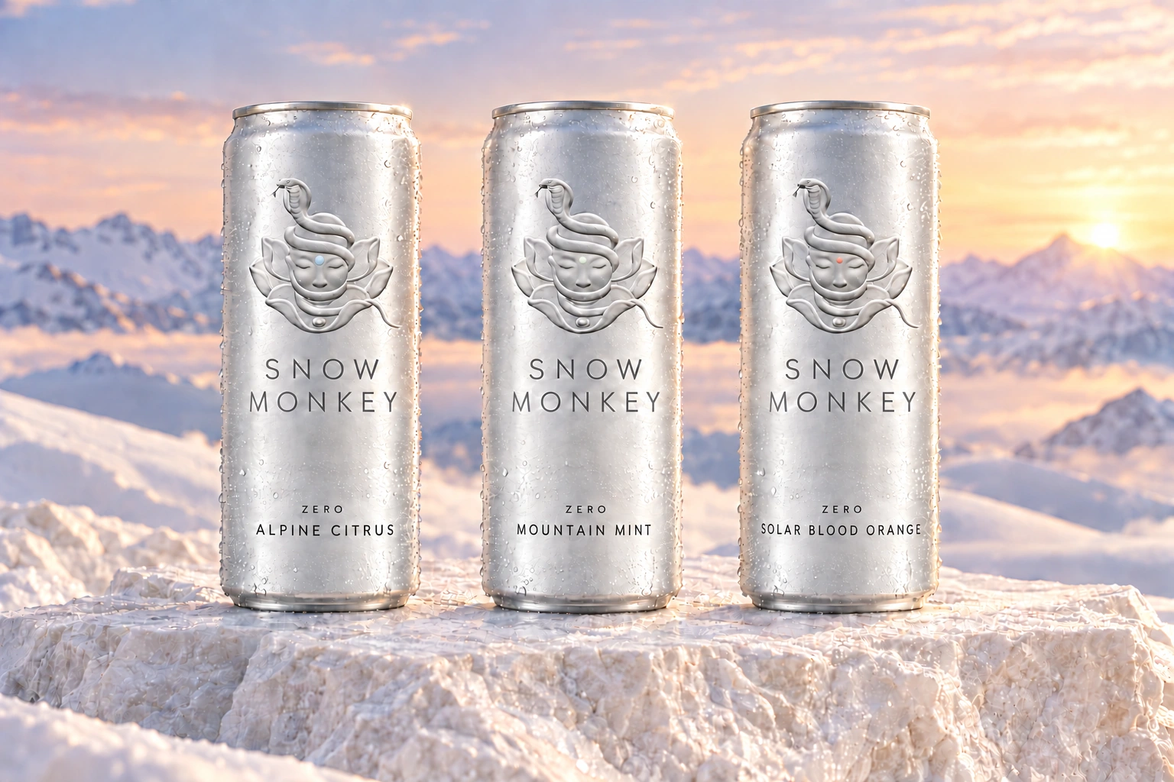
ZERO
Silver cans. A crisp, sparkling energy direction.
Caffeine + L-theanine
Sodium + potassium
B6 + B12
Zero sugar and zero calories
are formulation targets.
Early brief: 120 mg caffeine and 100 mg L-theanine per 12 fl oz. Development targets only. Final formula, nutrition and claims remain unvalidated.
04
Notes:
Sources: Lexus Neumann, Snow Monkey brand and formulation direction, October 28, 2026. Prior investor concept: SNOW_MONKEY_Investor_Brand_Presentation_Updated.pptx (Library file libfile_3163a94014808191803e97b21c5ab00b). The latest user direction supersedes the reversed can finishes in that earlier deck: ZERO silver, FUEL white with subtle iridescence. All packaging imagery is illustrative, generated during brand development. Strategy and milestones are proposals. No commercial traction, financial forecast, valuation or funding terms are represented as established.

Slide 5
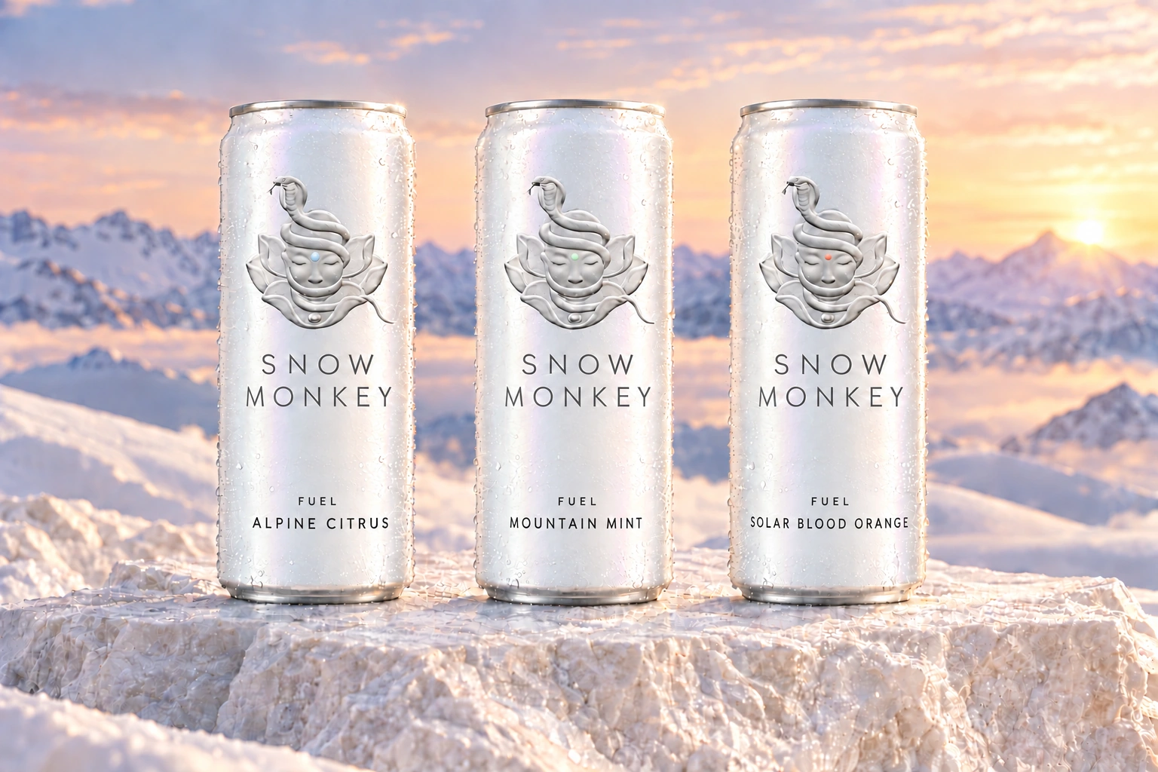
FUEL
White cans with subtle iridescence. The formulation with added MCT oil.
Medium-chain
triglyceride oil
A separate formula with its own
taste, texture and nutrition work.
Emulsion and shelf-life testing
are key development gates.
MCT quantity, caffeine level, calories and carbohydrate specifications remain open. FUEL does not inherit ZERO’s nutrition targets.
05
Notes:
Sources: Lexus Neumann, Snow Monkey brand and formulation direction, October 28, 2026. Prior investor concept: SNOW_MONKEY_Investor_Brand_Presentation_Updated.pptx (Library file libfile_3163a94014808191803e97b21c5ab00b). The latest user direction supersedes the reversed can finishes in that earlier deck: ZERO silver, FUEL white with subtle iridescence. All packaging imagery is illustrative, generated during brand development. Strategy and milestones are proposals. No commercial traction, financial forecast, valuation or funding terms are represented as established.

Slide 6
Three flavors, shared across both formulations
FLAVOR | FOREHEAD DOT | SENSORY DIRECTION
Alpine Citrus | Pale icy blue | Yuzu, lemon, white citrus
Mountain Mint | Very light mint | Mint, cucumber, lime
Solar Blood Orange | Muted blood orange | Blood orange, berry, citrus
Silver logo. Closed eyes. One tiny dot centered on the forehead.
The can finish distinguishes the formulation. The dot identifies the flavor.
06
Notes:
Sources: Lexus Neumann, Snow Monkey brand and formulation direction, October 28, 2026. Prior investor concept: SNOW_MONKEY_Investor_Brand_Presentation_Updated.pptx (Library file libfile_3163a94014808191803e97b21c5ab00b). The latest user direction supersedes the reversed can finishes in that earlier deck: ZERO silver, FUEL white with subtle iridescence. All packaging imagery is illustrative, generated during brand development. Strategy and milestones are proposals. No commercial traction, financial forecast, valuation or funding terms are represented as established.

Slide 7
A proposed launch in stages
Each stage advances when product and customer evidence support the next commitment.
01 Validate
02 Prove
03 Expand
Finalize prototypes and sensory work. Qualify production options and cost both can finishes.
Pilot direct-to-consumer and selected specialty accounts. Measure repeat and contribution.
Consider premium retail, hospitality and fitness channels after the pilot establishes demand.
Commercial traction and channel partnerships are not yet established.
07
Notes:
Sources: Lexus Neumann, Snow Monkey brand and formulation direction, October 28, 2026. Prior investor concept: SNOW_MONKEY_Investor_Brand_Presentation_Updated.pptx (Library file libfile_3163a94014808191803e97b21c5ab00b). The latest user direction supersedes the reversed can finishes in that earlier deck: ZERO silver, FUEL white with subtle iridescence. All packaging imagery is illustrative, generated during brand development. Strategy and milestones are proposals. No commercial traction, financial forecast, valuation or funding terms are represented as established.

Slide 8
The economics to establish
DECISION | EVIDENCE NEEDED
Price and gross margin | Consumer price testing and costed manufacturing quotes
Channel contribution | Freight, fulfillment, trade spend and channel fees
Working capital | Minimum orders, lead times, deposits and inventory turns
Customer value | Repeat purchase, retention and acquisition cost
No historical revenue, verified unit economics or financial forecasts are available in this concept.
08
Notes:
Sources: Lexus Neumann, Snow Monkey brand and formulation direction, October 28, 2026. Prior investor concept: SNOW_MONKEY_Investor_Brand_Presentation_Updated.pptx (Library file libfile_3163a94014808191803e97b21c5ab00b). The latest user direction supersedes the reversed can finishes in that earlier deck: ZERO silver, FUEL white with subtle iridescence. All packaging imagery is illustrative, generated during brand development. Strategy and milestones are proposals. No commercial traction, financial forecast, valuation or funding terms are represented as established.

Slide 9
Milestones before a broader launch
Formula readiness
Sensory approval, stability and validated nutrition for each formulation.
Production readiness
Qualified manufacturing, feasible finishes and documented landed costs.
Brand readiness
Trademark clearance, packaging rights and final artwork review.
Demand evidence
Pilot sell-through, repeat purchase and viable channel contribution.
09
Notes:
Sources: Lexus Neumann, Snow Monkey brand and formulation direction, October 28, 2026. Prior investor concept: SNOW_MONKEY_Investor_Brand_Presentation_Updated.pptx (Library file libfile_3163a94014808191803e97b21c5ab00b). The latest user direction supersedes the reversed can finishes in that earlier deck: ZERO silver, FUEL white with subtle iridescence. All packaging imagery is illustrative, generated during brand development. Strategy and milestones are proposals. No commercial traction, financial forecast, valuation or funding terms are represented as established.

Slide 10
Capital priorities
The proposed capital plan funds the next evidence milestones.
Product development
Production preparation
Controlled launch
Formulation, stability, nutrition testing and substantiated labeling.
Can finish engineering, manufacturing qualification and pilot inventory.
Sampling, e-commerce and a measured pilot across selected accounts.
Raise amount, allocation, valuation and terms remain open pending a costed operating plan.
10
Notes:
Sources: Lexus Neumann, Snow Monkey brand and formulation direction, October 28, 2026. Prior investor concept: SNOW_MONKEY_Investor_Brand_Presentation_Updated.pptx (Library file libfile_3163a94014808191803e97b21c5ab00b). The latest user direction supersedes the reversed can finishes in that earlier deck: ZERO silver, FUEL white with subtle iridescence. All packaging imagery is illustrative, generated during brand development. Strategy and milestones are proposals. No commercial traction, financial forecast, valuation or funding terms are represented as established.

Slide 11
Founder and operating model
Lexus Neumann
Founder and brand vision
Founder direction
Specialist execution to secure
A coherent visual identity and a considered approach to functional refreshment.
Beverage formulation, manufacturing, regulatory review and commercial operations.
11
Notes:
Sources: Lexus Neumann, Snow Monkey brand and formulation direction, October 28, 2026. Prior investor concept: SNOW_MONKEY_Investor_Brand_Presentation_Updated.pptx (Library file libfile_3163a94014808191803e97b21c5ab00b). The latest user direction supersedes the reversed can finishes in that earlier deck: ZERO silver, FUEL white with subtle iridescence. All packaging imagery is illustrative, generated during brand development. Strategy and milestones are proposals. No commercial traction, financial forecast, valuation or funding terms are represented as established.

Slide 12
Investor diligence priorities
AREA | OPEN QUESTION
Product | Can both formulas deliver taste, stability and compliant claims?
Supply | Can the silver and white iridescent finishes meet cost and MOQ needs?
Demand | Will the intended consumer pay the tested price and buy again?
Execution | Are specialist capability, working capital and operating terms in place?
The current asset is a developed brand and product concept. Launch timing and commercial performance remain unproven.
12
Notes:
Sources: Lexus Neumann, Snow Monkey brand and formulation direction, October 28, 2026. Prior investor concept: SNOW_MONKEY_Investor_Brand_Presentation_Updated.pptx (Library file libfile_3163a94014808191803e97b21c5ab00b). The latest user direction supersedes the reversed can finishes in that earlier deck: ZERO silver, FUEL white with subtle iridescence. All packaging imagery is illustrative, generated during brand development. Strategy and milestones are proposals. No commercial traction, financial forecast, valuation or funding terms are represented as established.

Slide 13
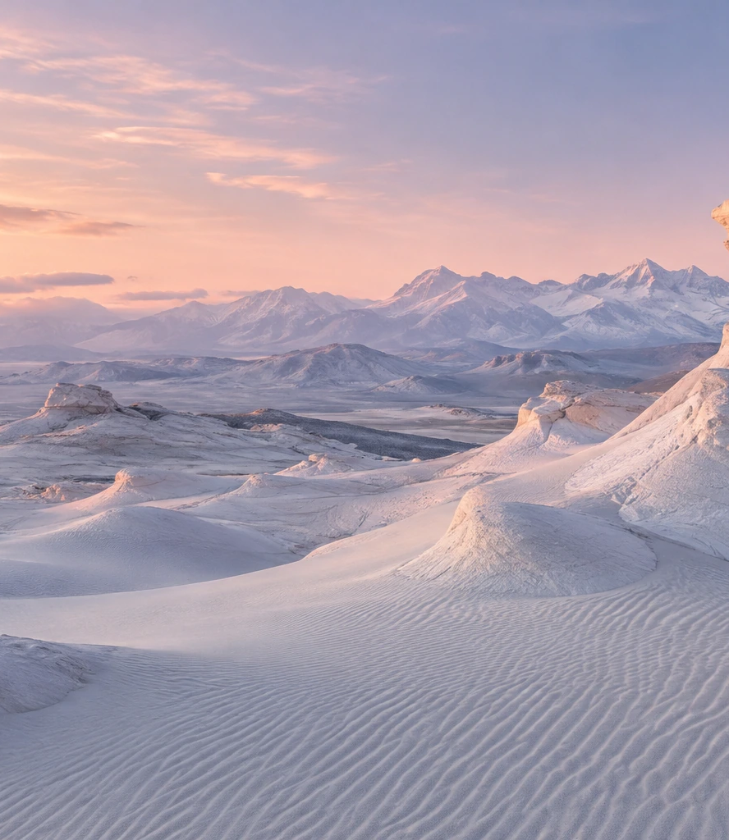
SNOW MONKEY
Built for
the extremes
The next chapter: validated formulas
and a disciplined pilot launch.
Lexus Neumann / Founder
Notes:
Sources: Lexus Neumann, Snow Monkey brand and formulation direction, October 28, 2026. Prior investor concept: SNOW_MONKEY_Investor_Brand_Presentation_Updated.pptx (Library file libfile_3163a94014808191803e97b21c5ab00b). The latest user direction supersedes the reversed can finishes in that earlier deck: ZERO silver, FUEL white with subtle iridescence. All packaging imagery is illustrative, generated during brand development. Strategy and milestones are proposals. No commercial traction, financial forecast, valuation or funding terms are represented as established.

